Slide 1

ONLINE REGISTRATION OF BUS PASS
Software Engineering and Project Management – 18CSC206J
BATCH NO : 13
NIKITH KUMAR S – RA1911003020480
VIGNESH P – RA1911003020468
ROHITH S – RA1911003020474

Slide 2
INTRODUCTION
This project was created to provide "safe, reliable, timesaving, efficient, comfortable and affordable" service for people.
It makes the passenger easy to travel with the ticket QR code with the mobile.
So that even if the passenger loses the ticket at the time of checking he can show the QR code.
The TTE can check the QR code with the Admin weather matches or not

Slide 3
PROBLEM STATEMENT
The present conventional method of ticketing is tedious. Since the volume of passengers is very high.
Manual ticket buying concept involves a lot of time, effort and manpower.
This system is highly unsuitable when there is a huge rush of commuters and many times, lot of commuter’s fail to catch their Bus. This is not only affecting the efficiency of people at their work place but also affecting them psychologically by less respect to co-passengers, staff members and at the end of the day at home.

Slide 4
PROPOSAL
The commuters of Public Transport can be categorized in to two categories namely:
1 . Regular commuters
2 . Short Time Commuters
Nowadays , We are using more network and communications with high speed data exchange we are introducing it in a new way to use for ticketing in Public Transport System
In Online Ticketing , a commuter will use his or her Online System to access the bus pass of entry and exit of bus stations. It may be done using mobile network/Net connection. The fair for distance travelled will be deducted from available balance of Debit card/credit cards
Anyone can avail this service by registering account from his or her mobile in a specified registration guidelines and they can start travelling after activation of service.
Using Online for ticketing , it will help to overcome billing hurdles and its fast and widely available network will suitable for communication and information exchange among entry and exit stations, Transport Service Provider Data Centre and Mobile Service Provider for billing purpose.

Slide 5
BUSINESS CASE :
DATE | 03/02/2021
SUBMITTED BY : | NIKITH KUMAR (480) VIGNESH (468) ROHITH (474)
TITLE : | Online Registration of Bus Pass
THE PROJECT:
This Project “Online Registration of Bus Pass “ is a real time project which is useful for the commuters who are facing problems with the current manual work of bus system. It makes the passenger easy to travel with the ticket QR code with the mobile. So that even if the passenger loses the ticket at the time of checking he can show the QR code. The TTE can check the QR code with the admin wheather it matches or not.
THE HISTORY:
Older days, Commuters are used spend more time in Que to register their bus pass . Lot’s of commuter are lose to catch their buses. This is not only affecting the efficiency of people at their work place but also affecting them psychologically by less respect to co-passengers, staff members and at the end of the day at home.

Slide 6
Limitations:
Volume of the Commuter’s is Very High.
Manual buying ticket/bus pass requires lots of time, Effort and Manpower.
Lot’s of travelers are lose to approach their buses at the time.
Approach:
Permission from Authentication process.
Software requirement to build an application.
Permission from Transport Service Provider Data Centre
Benefits:
We can save time.
Quick to catch their booked buses.
This system helps people to make the work a bit faster.

Slide 7
Stake Holders and User Description
STAKE HOLDERS:
User:
The users are the persons, who are using the online web or online services to register the bus pass.
Sponsor:
A sponsor is the person or group that provides the financial resources in kind or in cash for the project.
Program Manager:
They are responsible for managing related project in a coordinated way to obtain benefits and control.

Slide 8
Project Team :
A project team is comprised of the project manager, project management team and other team members who carry out the work.
Function Manager :
They are key individual who play a management role within an administrative or functional area of the business such as human resources, finance, accounting or procurement.
Transporters and Commuters management system :
This system is responsible for generating a message alert to the Bus pass Holders .
Registered Users :
After the Bus Pass Holder/Commuters has book their tickets/bus pass they can receive their ticket number(QR code)/bus pass application number.

Slide 9
USER STORY :
User’s End :
After Registration bus pass, the user will receive the message to their registered mobile or mail ID.
Advertising :
This agency promote the service through call centers, newspapers and even through the display the posters near bus stations.
IT Executive :
The agents will help to solve the Queries of the Commuters.
Technical Departrment :
The Employees in the technical department will be updating the web browser and solve the technical glitches/problems when arised.

Slide 10
MODULE :
Operating Module :
Sercure payment
Application management
Receives message alert notification for renewal of bus pass.
User Module :
Registering User
Updating Information
Generating pass
Renewal pass
Generating PDF
Generating QR Code
Problems faced :
Delaying in creation and deletion of message notification.
Tendious procedure for issuing/renewing passes.

Slide 11
Registration Process :
REGISTRATION
New User
Existing User
Login
Login
Form Registration
Renewal
Verification
Renewal Form
Payment
Payment
Bus Pass Generated

Slide 12
COMPARSION BETWEEN WATERFALL MODEL AND AGILE MODEL
WHY AGILE MODEL IS BETTER THAN WATERFALL MODEL??????
1. The Agile Model is based on iterative development and hence it divides the entire project into smaller parts which reduces the risk factor which is not the case in waterfall model.
2.The Waterfall model cannot accept the changes in requirements but in agile model it is easy to change the system requirements.
3.In agile model, the entire project is divided into smaller parts which helps to minimize the project risk and to reduce the overall project delivery time requirements.
4. In waterfall model since risk factor is high, it is not suitable for complex projects.
5.In waterfall model the testing is done in later stage it does not allow identifying the challenges and risks in the earlier phase, so the risk reduction strategy is difficult to prepare, which is not the case in agile model.

Slide 13
6. In waterfall model, it follows a sequential approach whereas in agile model it explains the process in order of incremental approach.
7.In agile it performs the testing concurrently with software development whereas in waterfall model the testing comes after the build phase only.
8.In agile model the distance between the customer and developer is in short whereas in waterfall model it is long.
9.In agile there can be done any change in the project but in waterfall model there is no changes throughout the project work.

Slide 14
IDENTIFYING THE REQUIREMENTS FROM THE PROJECT STATEMENT
REQUIREMENTS :
The requirement definition is concerned with the analysis of the existing system with the aim of determining and structuring the requirement of the proposed system. It is achieved with the aid of user requirement.
Requirement analysis determines the needs to be fulfilled and what the prepared document should do after completion. For the better understanding of the requirements we will draw the context diagram then build a prototype, analyse the requirements and lastly finalise them. In feasibility we analyses the feasibility of the project in terms of economic feasibility, technical feasibility and operational feasibility.
SYSTEM REQUIREMENTS :
List of City/Local Busses and Bus Stations.
GPS Tracker supported for the city busses.
Alert message generating System(For Renewal Process /Any maintenance Work).

Slide 15
FUNCTIONAL REQUIREMENTS :
REGISTERING USER
UPDATING INFORMATION
GENERATING PASS
RENEWING PASS
AUTHENTICATION OF USER
LOG IN
ONLINE PAYMENT
GENERATING PDF
GENERATING QR CODE
NON-FUNCTIONAL REQUIREMENTS :
RELIABILITY.
AVALIABILITY.
THIS WEB APPLICATION WILL BE AVALIABLE IN FEW LANGUAGES.
SECURITY.
STABILITY

Slide 16
PROJECT PLAN AND PROJECT EFFORT BASED ON RESOURSES
Project Name :
Online Registration of Bus Pass
Project Members :
VIGNESH P –RA1911003020468
NIKITH S -RA1911003020480
ROHITH S -RA1911003020474
The following budget is set according to the requirements :
Resource Requirements | Cost
Computer higher CPU and a Windows 10 or higher OS | Rs.30000
Printing | Rs.500
Node.Js | FREE
File | Rs.50
TOTAL | Rs.30550

Slide 17
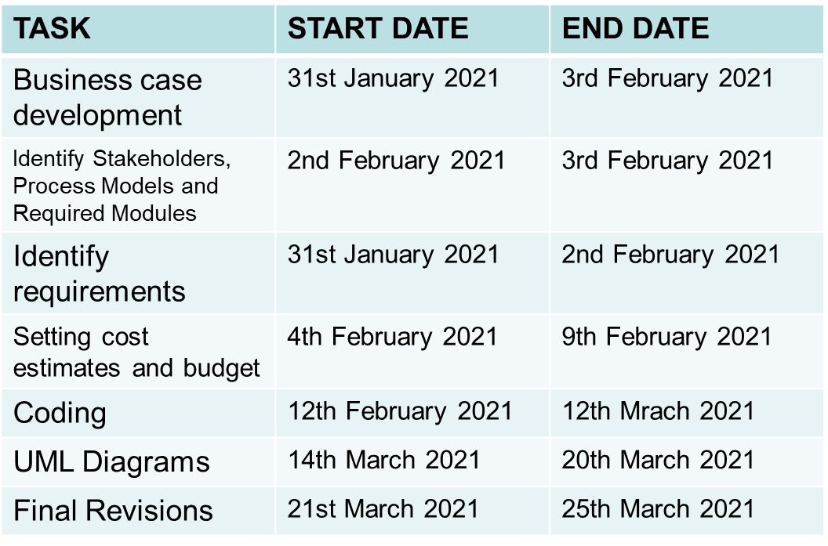
MODULES :
Login
Update
Display
Check
SCHEDULING :

Slide 18
Software and Hardware requirements for the system:
QR code Scanner.
Web Application.
PHP.
Any Operating System.
MySQL Databases.
JAVASCRIPT , HTML, Graphics Supported Browser.
System must be Connected to the Server.
Atleast 1GB RAM is required.
Identify Job Roles and Responsibilities :
Members | Roles and Responsibilities
VIGNESH P | Team Leader -Technical Lead -Web Developer
NIKITH S | Team Member -Web Developer
ROHITH S | Team Member -Tester

Slide 19
JOB ROLES AND RESPONSIBILITIES :
PROJECT SPONSOR:
Project sponsor is the one who provides the financial support for the whole project development and execution. They also monitor the process and clarifies scope questions. They also provide expert judgement and dictate milestones, key events, or the project end date.
SUBJECT MATTER EXPERTS (SME):
SME is a person who has a special skills or knowledge on particular job or topic. They have a deep understanding of particular process, function or machine and hence they help to solve the technical challenges faced by the project.
PRODUCT OWNER:
A Product Owner in the Scrum Framework is the single person who is responsible for the success of a Product and for maximizing the value of that Product. In the Scrum Framework, a few of the Product Owners' responsibilities are described, such as Product Backlog management, maximizing value and stakeholder management.
PROJECT MANAGER (PM):
A project manager is a professional in the field of project management. Project managers have the responsibility of the planning, procurement and execution of a project, in any undertaking that has a defined scope, defined start and a defined finish; regardless of industry.

Slide 20
TECHNICAL LEAD:
This person is responsible for overall planning, execution and success of overall complex software solutions to meet customers needs. They have to implement best practice and coding standards to the project. They have to manage the technical scope of the project during and after the delivery.
SOFTWARE DEVELOPERS:
Individual who builds and creates an application is called software developers. They write and debug and then execute the source code of the software application. They are also called as programmers since they are the ones that create the programs or the source code.
SOFTWARE TESTERS:
Their main role is to check if the actual result match the expected result and to ensure the software system is defect free. Software testing helps to identify the errors or the missing requirements due to which it becomes a vital role. It can be either manually or by using automated tools.
USER ACCEPTANCE TESTERS:
This testing is performed by end user or client to accept the software system before moving the software application to the moving environment. This is usually the last process involved in the project management.
WEB DEVELOPER:
A web developer is a programmer who specializes in, or is specifically engaged in, the development of World Wide Web applications using a client–server model. The applications typically use HTML, CSS and JavaScript in the client, PHP in the server, and http for communications between client and server. A web content management system is often used to develop and maintain web applications.

Slide 21
PROJECT EFFORT BASED ON RESOURCES
WORK BREAKDOWN STRUCTURE:
The work breakdown structure of the project is given below:
Online Registration of Bus Pass
Analysis
Requirement
System Design
Development
Testing
Implementation
Feasibility
Functional
System Requirements
Physical system design
QA testing
Acceptance Testing
Online
Users
Non Functional
Website
Maintenance
Designable
Programming
Database
Database
Network
Cost
Materials
Hire programmer
Hire database engineer
Hire network engineer
Update system
Train maintenance

Slide 22
RISK ANALYSIS:
PASSENGER PRIVACY AND DATA:
Passenger details should be provide information about the traveler. We do not sell or share any personally identifiable information volunteered on the bus pass website to any third party(public/private). Any information provided to this portal will be protected from loss, misuse, unauthorized access or disclosure, alteration, or destruction.
BUS PASS ELIGIBLE CRITERIA:
In pursuance of the policy of Central Government, Corporation has implemented the facility of issuing free bus passes to all the Students below 14 years of age, to travel free from the residence to school.
In order to carry their school ID card and Xerox copy of Aadhar card.

Slide 23
Issuing bus passes to the Physically challenged, mentally retarded, blind, deaf & dumb, dwarf persons and etc., and above 60 aged travelers, to travel free by the buses operating in cities / towns. In case of services operating in rural areas, these physically challenged persons are allowed 40%-50 % concession in normal fares.
CRIME:
If your Pass has been stolen, report it to the Police and they will give you a Crime Reference Number. There will be no charge if you order a replacement Bus Pass when you provide your Crime Reference Number. Please be aware you will need to submit a Crime Reference Number during the application.

Slide 24
ESTIMATION OF PROJECT MATRICES Function Point Analysis:
Objective of FPA:
The basic and primary purpose of the functional point analysis is to measure and provide the software application functional size to the client, customer, and the stakeholder on their request. Further, it is used to measure the software project development along with its maintenance, consistently throughout the project irrespective of the tools and the technologies.
Types of FP Attributes
Measurements Parameters Examples
1.Number of External Inputs(EI) - Input screen and tables
2. Number of External Output (EO) - Output screens and reports
3. Number of external inquiries (EQ) - Prompts and interrupts.
4. Number of internal files (ILF) - Databases and directories
5. Number of external interfaces (EIF) - Shared databases and shared

Slide 25
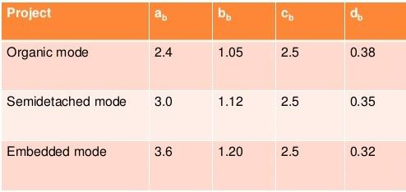
COCOMO Model:
E = ab(KLOC)bb
D = cb(E)b
P = E / D
Where E refers to the effort, D refers to the deployment time ,P refers to the productivity and ab,bb,cb,db are called as coefficients.

Slide 26
SYSTEM DESIGN:
Here we have used the basic software front end design model in order to represent the system architecture of our software model.
LOGIN
REGISTER/
RENEWAL PROCESS
VERIFICATION
LOGOUT
BUS PASS GENERATED
PAYMENT
The above is a simple form of system design diagram which uses front end design.
This shows a loop of functions that need to be executed when this project is implemented. This is a chain of operations through which this project is implemented.

Slide 27
MODELING USE CASE DIAGRAM AND SCENARIOS Use Case Diagram Description
Here there are three actors
User
Admin
TTE
With QR Code:
The registration use case has the relation with both user and admin.
The ID Proof use case has the relation with User have to submit the ID Proof to admin for verification.
User have to pay the amount for the pass.
After payment, User will collect/generate the ticket from the admin.
QR Code use case is related to User, TTE and the admin.
Without QR Code:
If user has lost the QR code pass. User has to buy the ticket or pay the penalty.
In the TTE use case, TTE has submit the records of the travelers to the Admin.

Slide 28
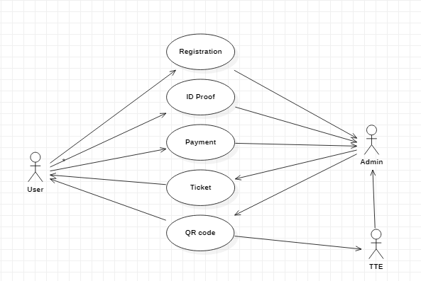
USE CASE DIAGRAM:
WITH QR CODE:

Slide 29
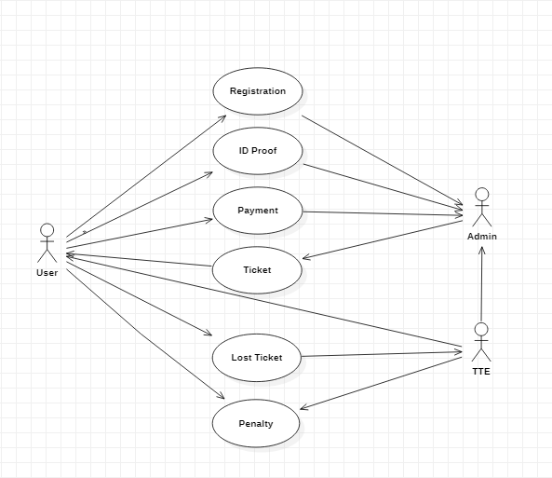
WITHOUT QR CODE:

Slide 30
ER MODELING FROM THE PROBLEM STATEMENT ER DIAGRAM DESCRIPTION:
An Entity-Relationship Model describes interrelated things of interest in a specify domain of knowledge. A basic ER Model is composed of Entity types and specifies relationship that can exist between entities.
The Details of the product are stored in the product tables
Each entity has a primary key and unique keys
The Entities set presented here are
User, Pass registration, Verification and Pass generation.
All the entities like user, type of registration, reduce duplicacy pass.
There is one to one relationship between travelers and the TTE.
The issue is araised when someone misuse the pass/ Stolen by someone.
Another Issues when the user pass has the date of expiration.
Then the request will be sent to the user for renewal of the pass.

Slide 31
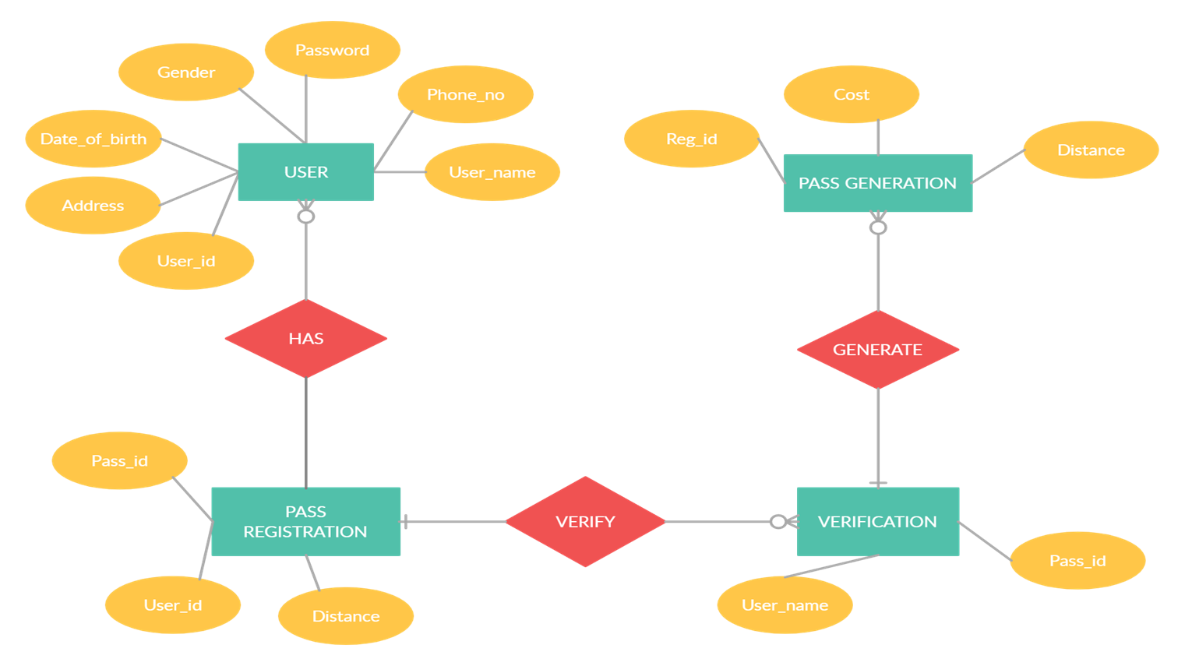
ER DIAGRAM:

Slide 32
THANK YOU

